Slide 1

Deep Neural Network Module # 7: RNN
DNN Team
BITS Pilani WILP

Slide 2
The instructor is gratefully acknowledging the authors who made their course materials freely available online.
This deck is prepared by Seetha Parameswaran.
Deep Neural Network

Slide 3










Table of Contents
Introduction to Sequence Modeling
Sequence Models Theory
Basic RNN Architecture
RNN Training & BPTT
Bidirectional RNNs
Deep (Stacked) RNNs
Gated Recurrent Units (GRU)
Long Short-Term Memory (LSTM)
Time Series Forecasting Applications
Comparison & Summary
1
2
3
4
5
6
7
8
9
10
Deep Neural Network

Slide 4



Motivation: Why Sequence Models?
Many real-world problems involve sequential data:
⁾ Natural Language: ”The cat sat on the ”
⁾ Time Series Forecasting: Stock prices, temperature prediction, sensor data
⁾ Speech: Audio signals over time
⁾ Video: Frame sequences
⁾ Genomics: DNA/protein sequences Key characteristic: Order matters Dependencies exist across time steps
The
cat sat ^{on}
the
?
Dependencies
Deep Neural Network

Slide 5
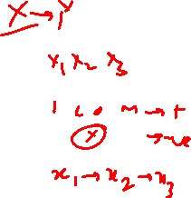
Why Feedforward Networks Fail?
Key issues:
⁾ Fixed input size: Cannot handle variable-length sequences
⁾ No memory: Each input processed independently
⁾ No parameter sharing: Different weights for each position
Example Problem: Predict next word in a sentence
⁾ Input: ”I grew up in France, so I speak fluent ”
⁾ Need context from 7 words back (”France”) to predict ”French”
⁾ Feedforward network treats each position independently
We need: A model that can remember past information
Deep Neural Network
5 / 96

Slide 6
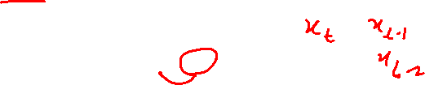
Temporal Dependencies
Short-term dependencies: Information needed is recent
⁾ ”The clouds are in the ” → ”sky”
Long-term dependencies: Information needed is far back
⁾ ”I grew up in France... I speak fluent ” → ”French”
Challenge: Model must learn to remember relevant information and forget irrelevant information.
Different sequence lengths require flexible architectures
Deep Neural Network

Slide 7


Table of Contents
Introduction to Sequence Modeling
Sequence Models Theory
Basic RNN Architecture
RNN Training & BPTT
Bidirectional RNNs
Deep (Stacked) RNNs
Gated Recurrent Units (GRU)
Long Short-Term Memory (LSTM)
Time Series Forecasting Applications
Comparison & Summary
1
2
3
4
5
6
7
8
9
10
Deep Neural Network

Slide 8
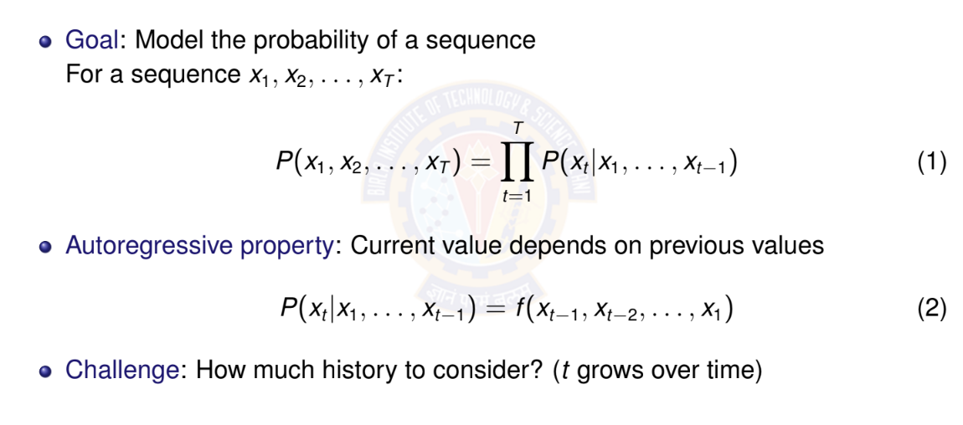
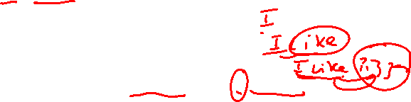
Autoregressive Models
Deep Neural Network

Slide 9

Autoregressive Models: Example
Sequence: ”The cat sat on the” Predict: Next word (e.g., ”mat”) Autoregressive decomposition:
P (The, cat, sat, on, the, mat) = P(The)
× P(cat|The)
× P(sat|The, cat)
× P(on|The, cat, sat)
× P(the|The, cat, sat, on)
× P(mat|The, cat, sat, on, the)
⁾ Each word depends on ALL previous words
⁾ History grows with sequence length
Deep Neural Network

Slide 10
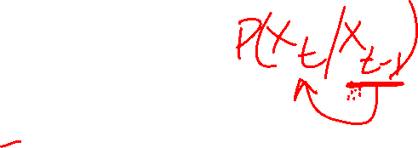
Markov Assumption
Simplification: Limit the context window
First-order Markov: Only immediate past matters
P(x_{t} |x₁, . . . , x_{t —1}) ≈ P(x_{t} |x_{t —1})
(3)
k -th order Markov: Last k steps matter
P(x_{t} |x₁, . . . , x_{t —1}) ≈ P(x_{t} |x_{t —k} , . . . , x_{t —1})
(4)
Advantage: Fixed-size context, tractable computation Disadvantage: May lose important long-term dependencies
Deep Neural Network

Slide 11

Markov Assumption: Example
Sequence: ”The cat sat on the” Predict: Next word (e.g., ”mat”) First-order Markov (bigram):
P(mat|The, cat, sat, on, the) ≈ P(mat|the)
Second-order Markov (trigram):
P(mat|The, cat, sat, on, the) ≈ P(mat|on, the)
Key insight:
⁾ Fixed context window (1 or 2 words)
⁾ Ignores earlier words like ”cat” and ”sat”
⁾ Computationally efficient but limited expressiveness
Deep Neural Network

Slide 12
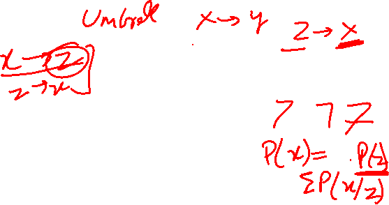
Latent Variable Models
Alternative approach: Summarize past with a hidden state
h_{t} = f (x_{t} , h_{t —1})
P(x_{t} |x₁, . . . , x_{t —1}) = P(x_{t} |h_{t} )
(5)
(6)
Key insight:
⁾ h_{t} is a latent (hidden) variable
⁾ Contains compressed summary of history
⁾ Fixed-size representation regardless of sequence length
⁾ Updated recursively at each time step
This is the foundation of RNNs!
Deep Neural Network

Slide 13
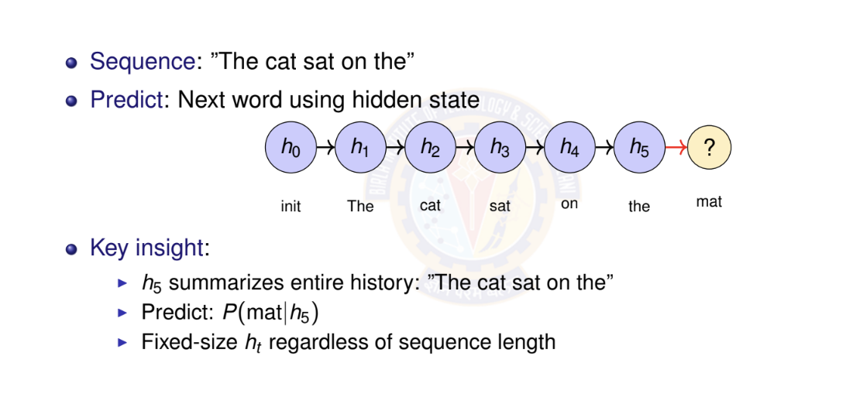
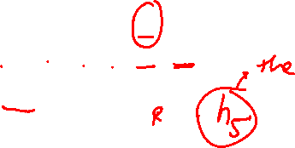
Latent Variable Models: Example
Deep Neural Network

Slide 14

Numerical Example: Temperature Forecasting - Setup
Task: Predict tomorrow’s temperature (regression) Observed sequence: 20◦C, 22◦C, 25◦C, 24◦C, 21◦C Approach 1: Autoregressive (First-order)
⁾ Linear relationship learned from data:
T_{t +1} = α · T_{t} + β
⁾ From historical data, we learned:
α = 0.8, β = 4.0
⁾ Example: If today is 25◦C:
T_{tomorrow} = 0.8 × 25 + 4.0 = 24.0◦C
Deep Neural Network

Slide 15

Temperature Forecasting - Autoregressive Prediction
Sequence: 20◦C, 22◦C, 25◦C, 24◦C, 21◦C Model: T_{t +1} = 0.8 · T_{t} + 4.0
Predict next day (day 6):
⁾ Last observation: T₅ = 21◦C
⁾ Prediction: T₆ = 0.8 × 21 + 4.0 = 20.8◦C
Multi-step ahead (day 7, using predicted T₆):
⁾ T₇ = 0.8 × 20.8 + 4.0 = 20.64◦C
Limitation: Only uses immediate past
⁾ Cannot capture weekly/seasonal patterns
⁾ Error accumulates in multi-step predictions
Deep Neural Network

Slide 16
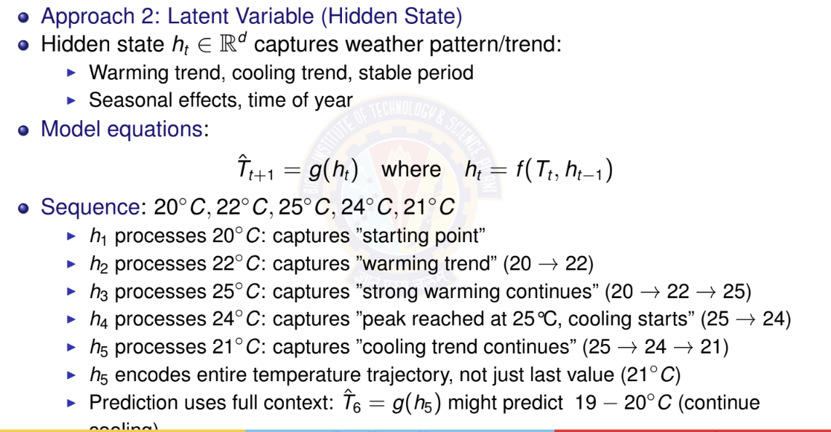
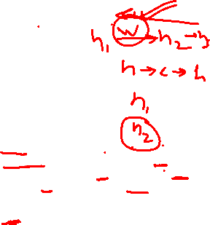
Temperature Forecasting - Latent Variable Model
Deep Neural Network

Slide 17

Table of Contents
Introduction to Sequence Modeling
Sequence Models Theory
Basic RNN Architecture
RNN Training & BPTT
Bidirectional RNNs
Deep (Stacked) RNNs
Gated Recurrent Units (GRU)
Long Short-Term Memory (LSTM)
Time Series Forecasting Applications
Comparison & Summary
1
2
3
4
5
6
7
8
9
10
Deep Neural Network

Slide 18

References
Zhang, A., Lipton, Z. C., Li, M., & Smola, A. J. (2023). Dive into deep learning. Cambridge University Press. Chapters 6 and 7.
Goodfellow, I., Bengio, Y., Courville, A. (2016). Deep Learning. MIT Press.
Deep Neural Network

